Slide 1
DATA SCIENCE PRACTICUM PROJECT 2 TEAM CRAGG
ANUJ PANCHMIA , RUTU GANDHI , SUSHANTH KATHIRVELU

Slide 2
Type of problem
Semantic segmentation aims at grouping pixels in a semantically meaningful way.
So semantic segmentation does a pixel-wise classification
The two popular models that work well:
UNet
MaskRCNN

Slide 3
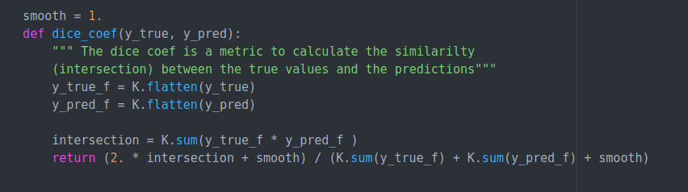
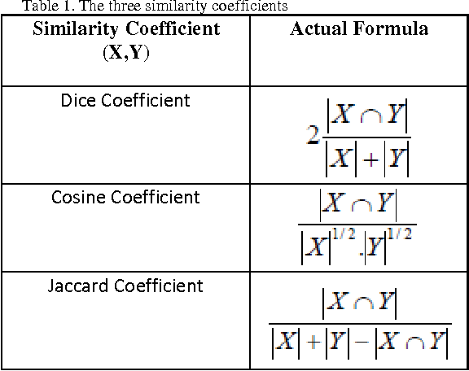
Dice loss

Slide 4
PRE-PPROCESSING
Resizing
Zero Padding
Variance
Grayscale
FFT
Optical Flow
Video2
Frames(1st and 50th)
Mean of Optical Flow and Variance

Slide 5


Resize
(256, 256) and (512, 512)

Slide 6
Zero Padding
Strategy 1: Zero Pad and tile
x=128 y=128
image size = (640,480)
zero padding : 640 = 5x, 480 = 3.75y
Tile
Strategy 2: Simple zero padding into (640, 640)

Slide 7
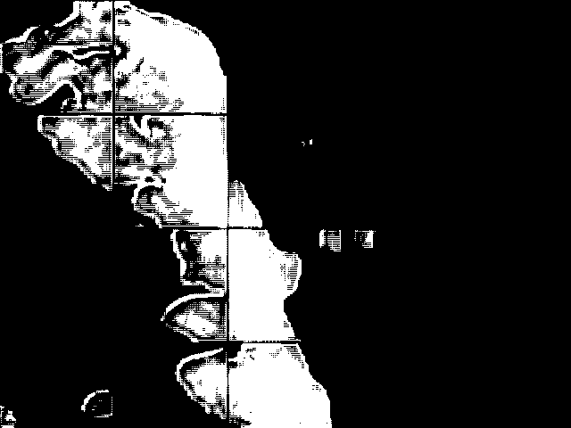
Tailor and Stitch

Slide 8
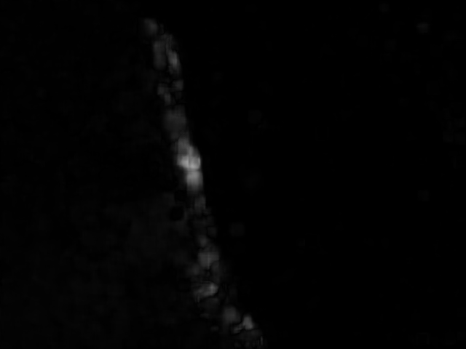
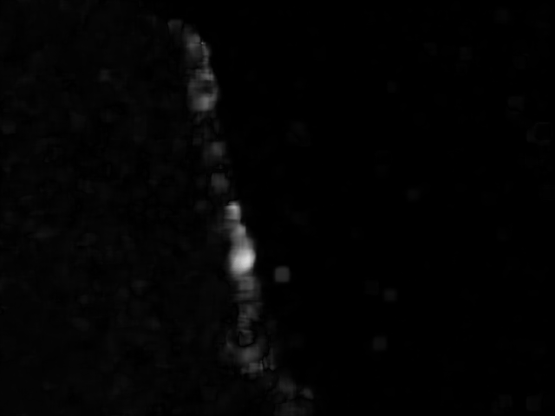
Optical Flow

Slide 9
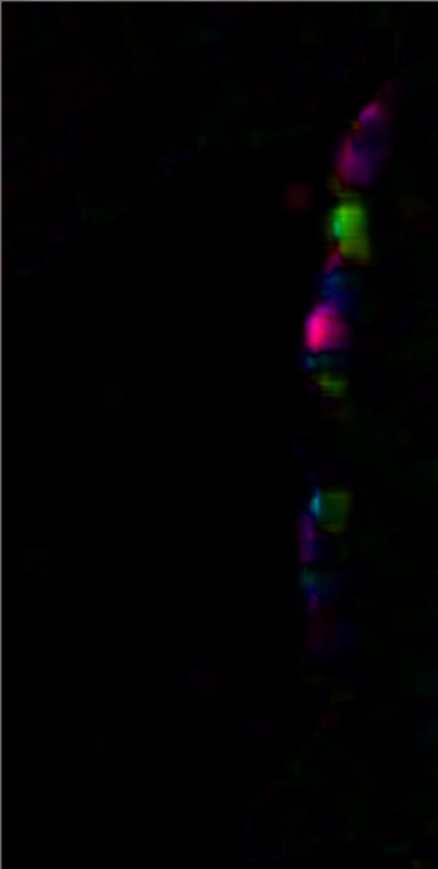
Optical Flow Video

Slide 10
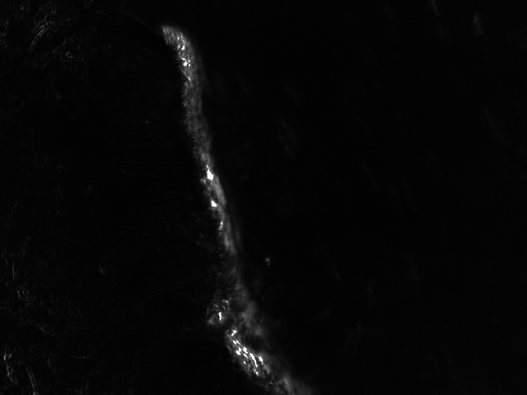
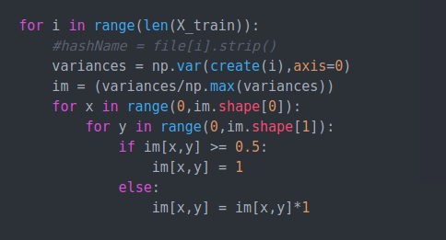
Gray Scale variance

Slide 11
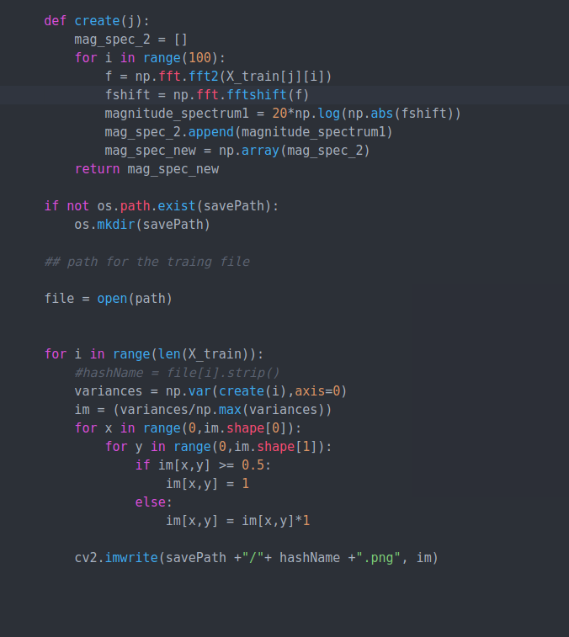
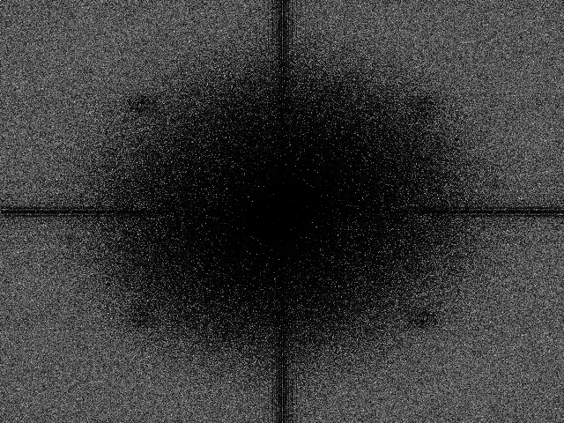
FFT + variance

Slide 12
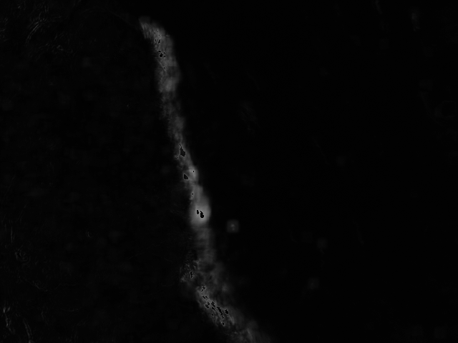
Gray scale variance + Optical Flow averaging

Slide 13
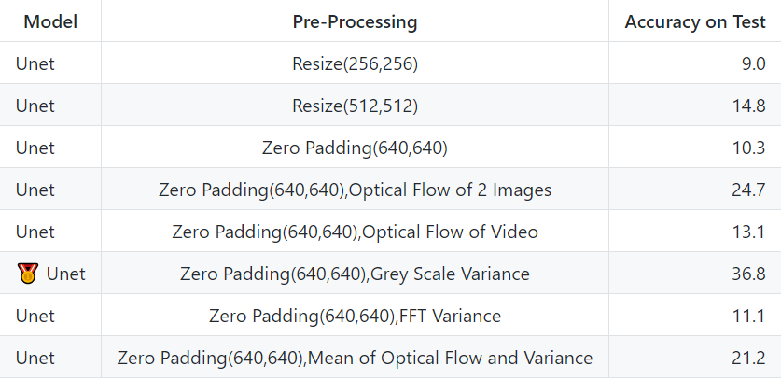
RESULTS

Slide 14
THANK YOU
Questions??

